Slide 1
Emergence of Agriculture. First agrarian civilization
Lecture 1
Andrii Pastushenko
PhD in Historical Sciences, associative professo

Slide 2
Neolithic revolution
Agriculture
Foraging

Slide 3
Pleistocene
Holocene
Climate
11 500 years ago

Slide 4
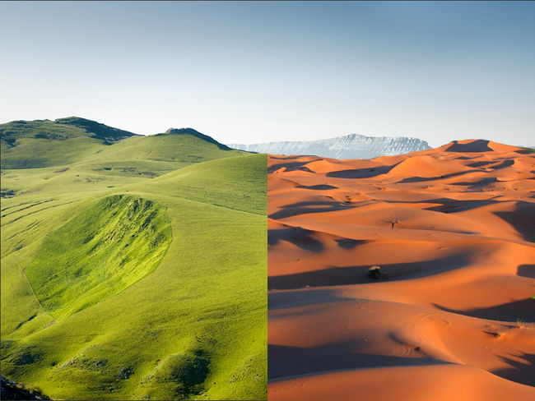
10 000 – 4 000 BCE
NOW

Slide 5
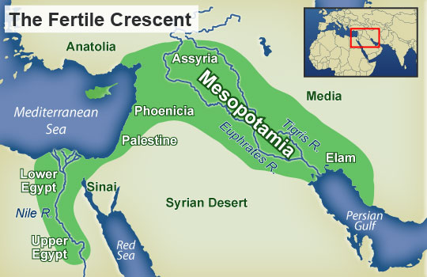

Slide 6
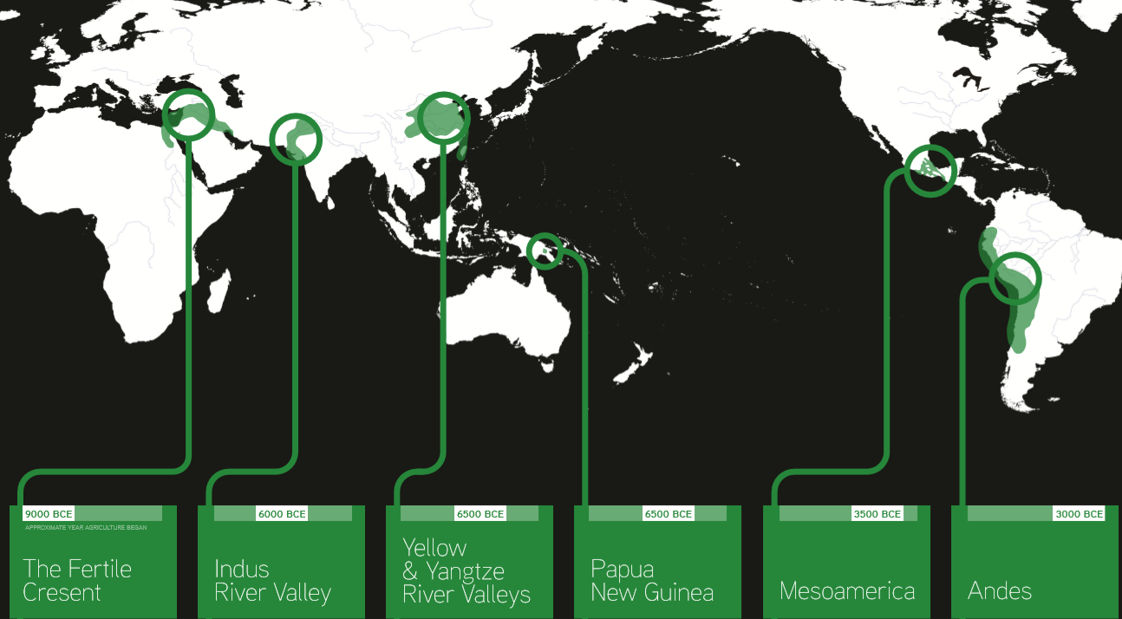
Early hubs of agriculture

Slide 7
Three world zones

Slide 8
The Natufians

Slide 9
5 000 years ago
50 mln
10 000 year ago
6 mln

Slide 10
Irrigation

Slide 11
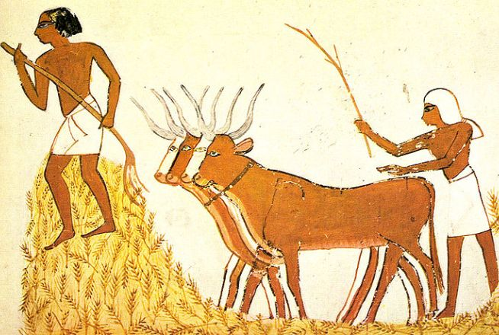

Slide 12
Gender hierarchy

Slide 14
The city of Jericho

Slide 16
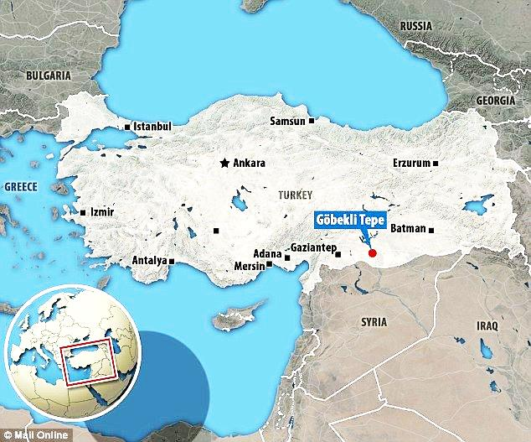

Slide 17
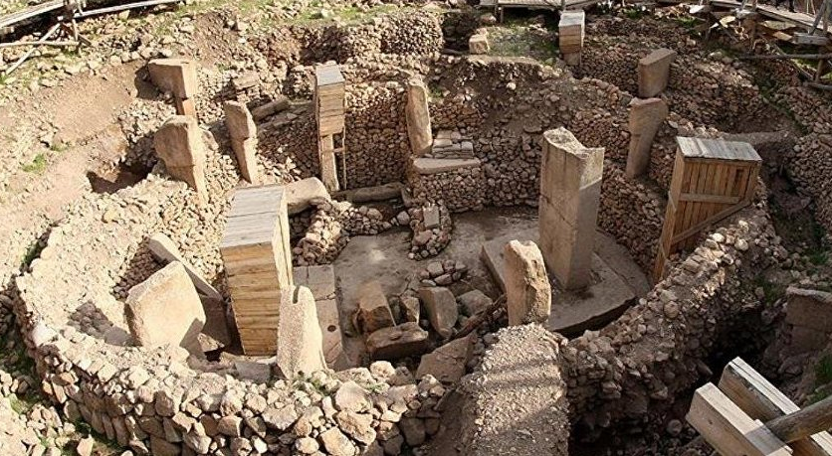
Göbekli Tepe (10 000 – 8 000 BP )

Slide 18
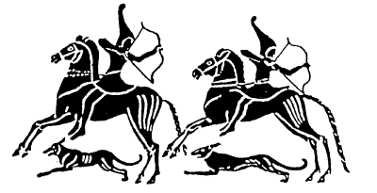

Slide 19
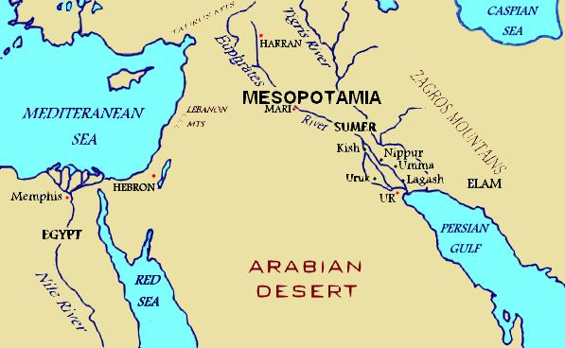
The Sumerians

